Slide 1
By: Graham Haun

Slide 2
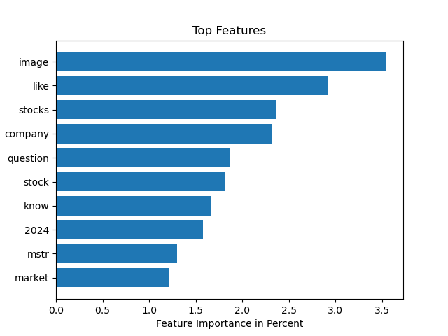
Top 10 Features
Image: A post with only a picture
mstr: Micro Strategy stock ticker

Slide 3
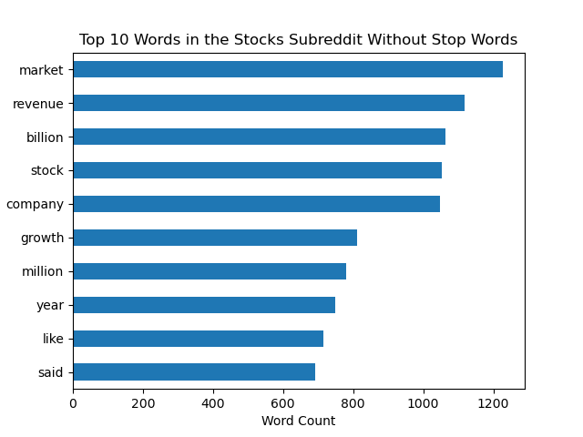
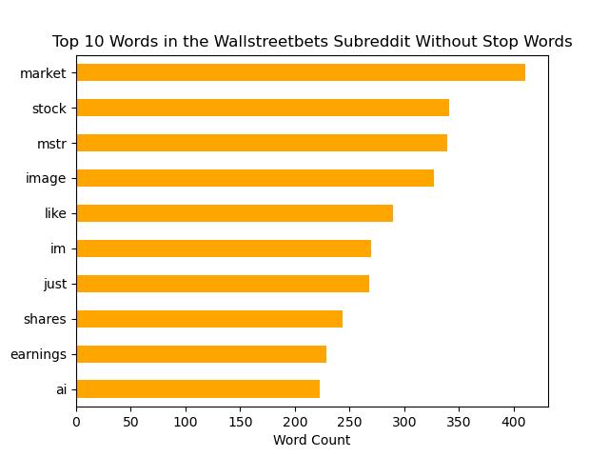
The Top 10 Words

